Slide 1
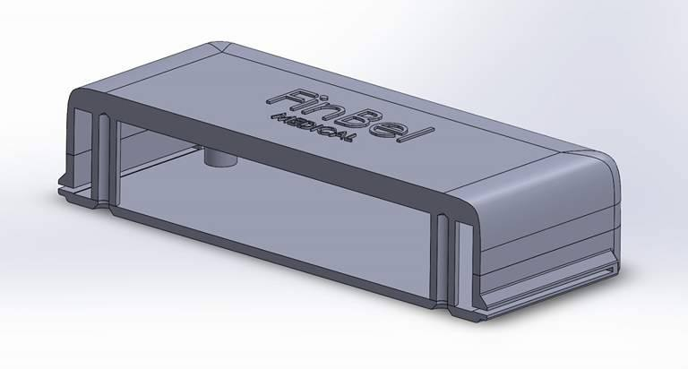
FINBEL ECG
Veli-Pekka Porrassalmi
Marko Ylikulju
Chingiz Mizambekov
Steven Dijcks

Slide 2
Hardware Device
Veli-Pekka & Marko

Slide 3
The Circuit
Amplifier
Low pass / High pass filter
Summing amplifier
SD card
A/D conversion
RC filter

Slide 4
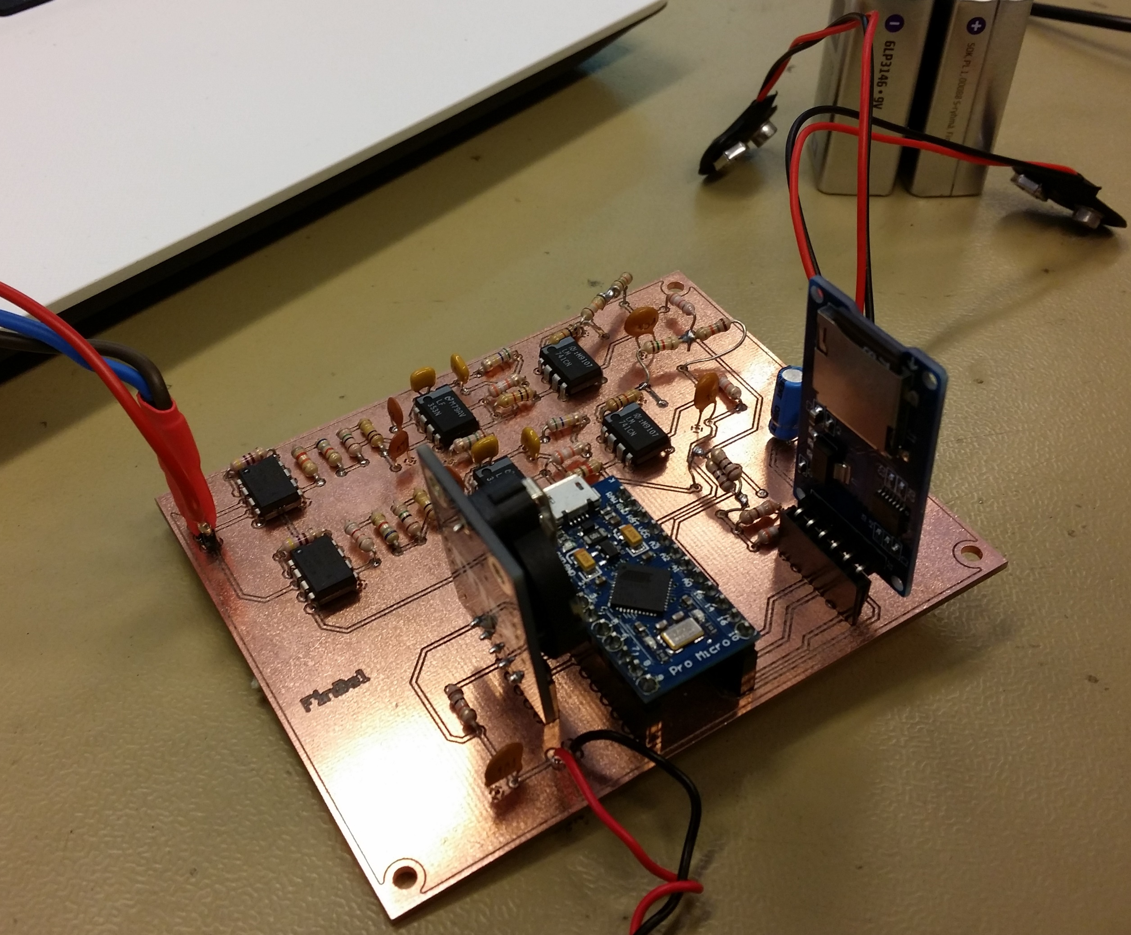

Slide 5
Amplifier
2x INA128-instrumentation amplifiers
Gain(Au) = ~107
3x Electrodes
Lead(1)
Lead(2)
Lead(ref)
2x ECG signal outputs
U(o1)
U(o2)

Slide 6
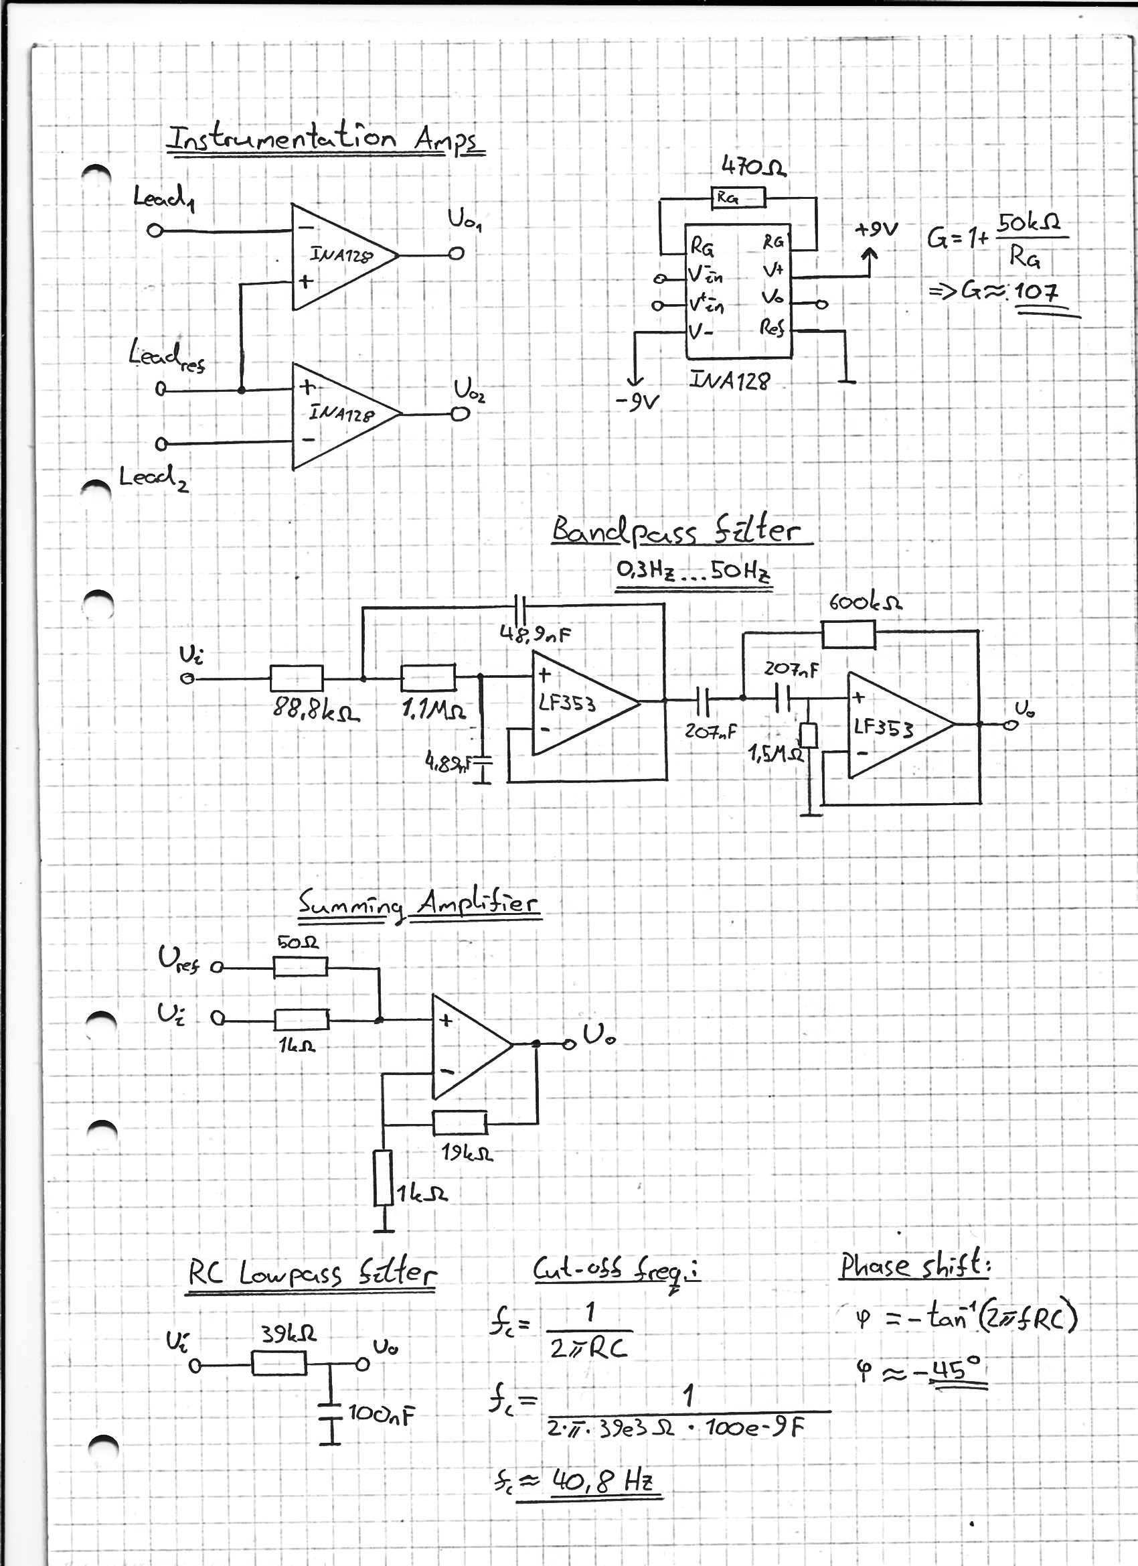
Bandpass filter
Pass band 0,3Hz … 50Hz
LF353N opamp
First part low rejection
Second part high rejection

Slide 7
Summing amplifier
Purpose to raise the voltage level
ECG signal >0V
Enables the A/D conversion on Arduino MCUs’
LM741

Slide 8
RC lowpass filter
Removing noise before A/D conversion
Cut-off frequency>40,8Hz

Slide 9
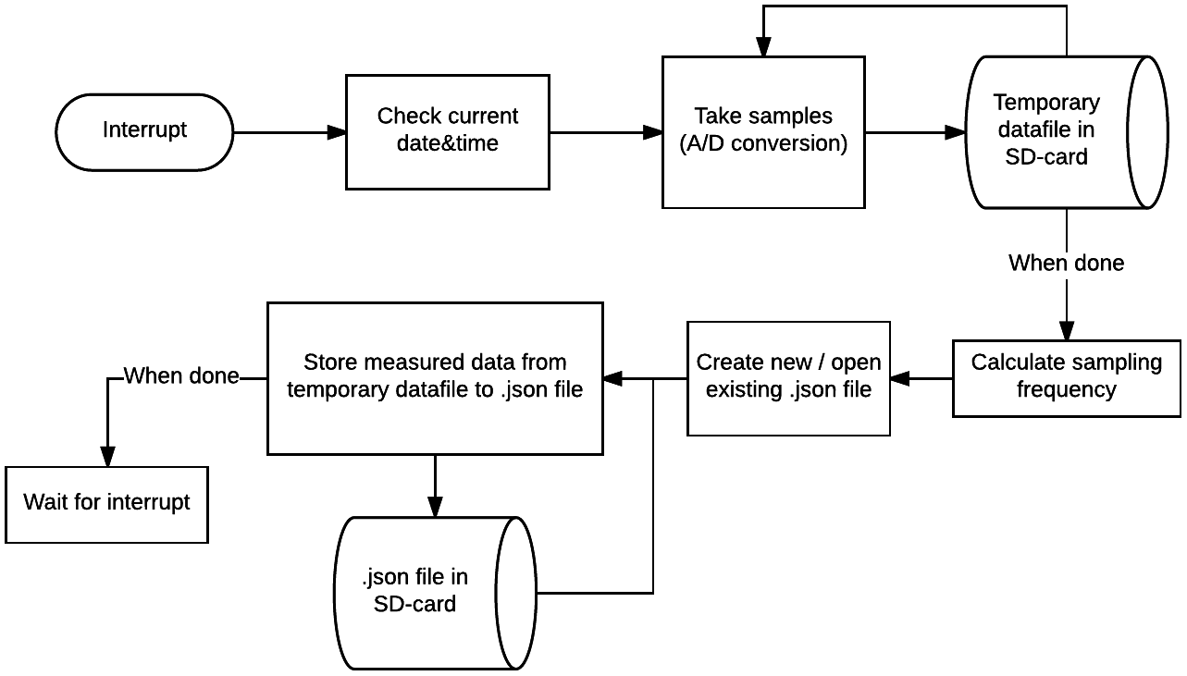
Flowchart of Firmware Simplified

Slide 10
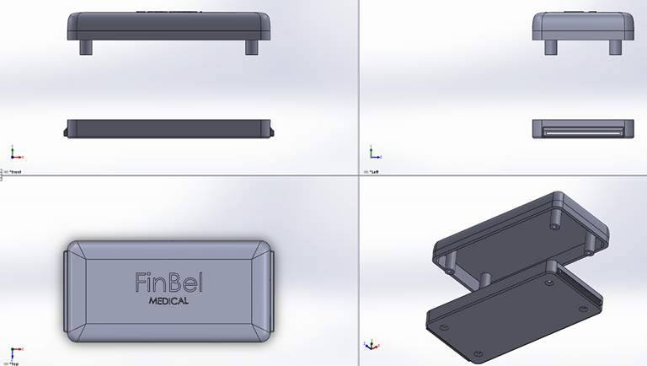
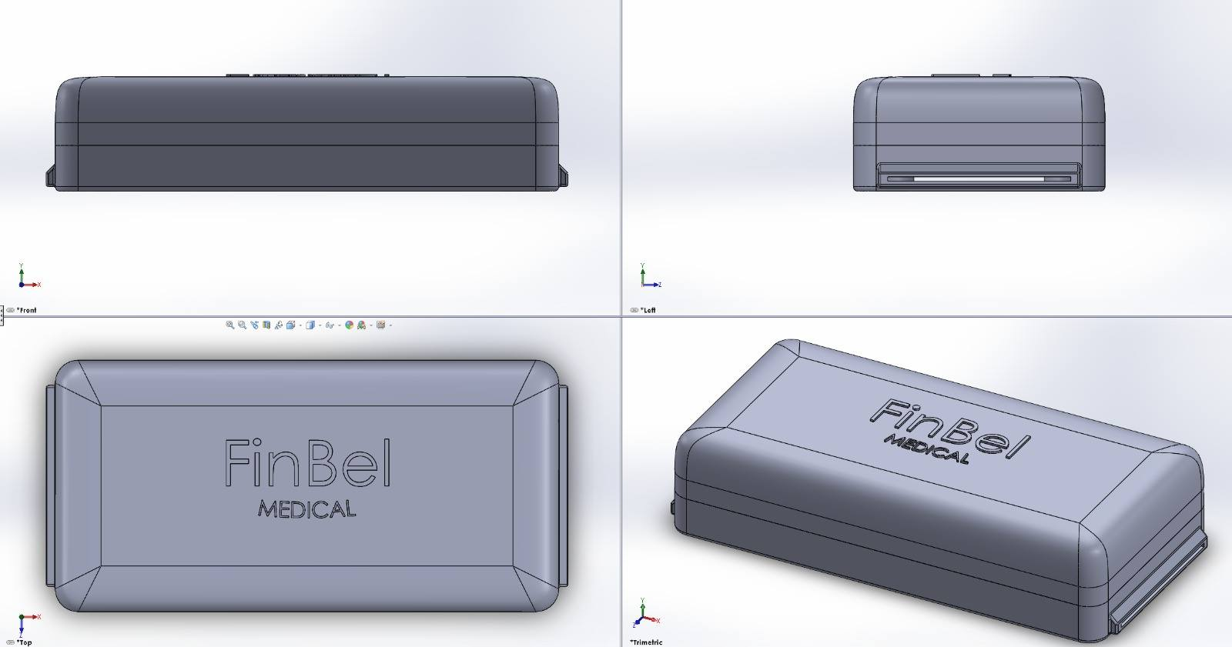

Slide 11
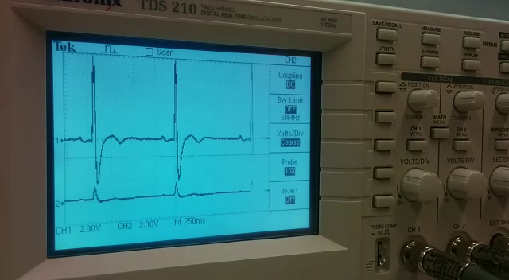

Slide 12
Front & Back-end Website
Chingiz & Steven

Slide 13
FINBEL ECG App
MEAN App
Full control over client and server side
App runs on a RPi server at home

Slide 14
General Features
Create profile
Login to personalized dashboard with sessions
User input validation
Feedback on all forms
Contact form to send emails
List of nearby hospitals in Antwerp

Slide 15
Personal Dashboard
View profile info
Upload new record (.json)
View all the records
Algorithm analyzing your records
Button to share your records with a doctor

Slide 16
Original Goals
Hardware
Device to measure the ECG
Software
Create account and login to personal space
Upload ECG
Display ECG
Analyse ECG
Contact product owners
Share ECG with doctor
Extra
List of nearby hospitals in Antwerp

Slide 17
Algorithm

Slide 18
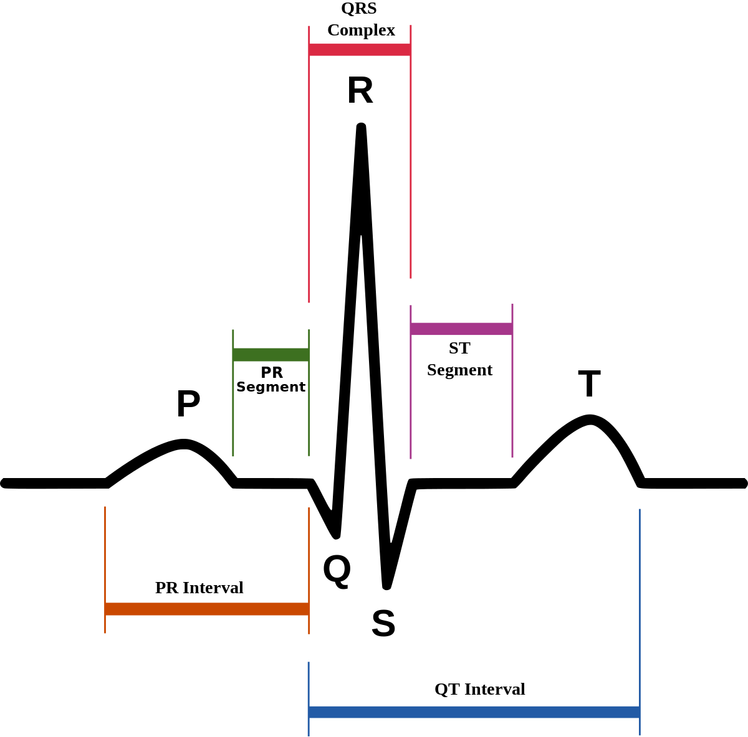
Normal ECG
R Peak
QRS Complex
P Wave
P-R Interval
R-R Interval
BPM

Slide 19
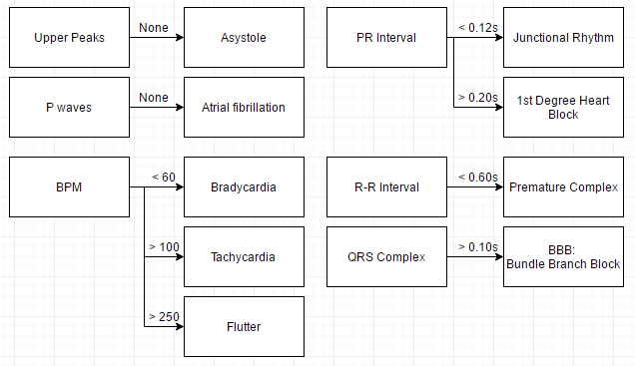
Arrhythmia’s we can detect:

Slide 20
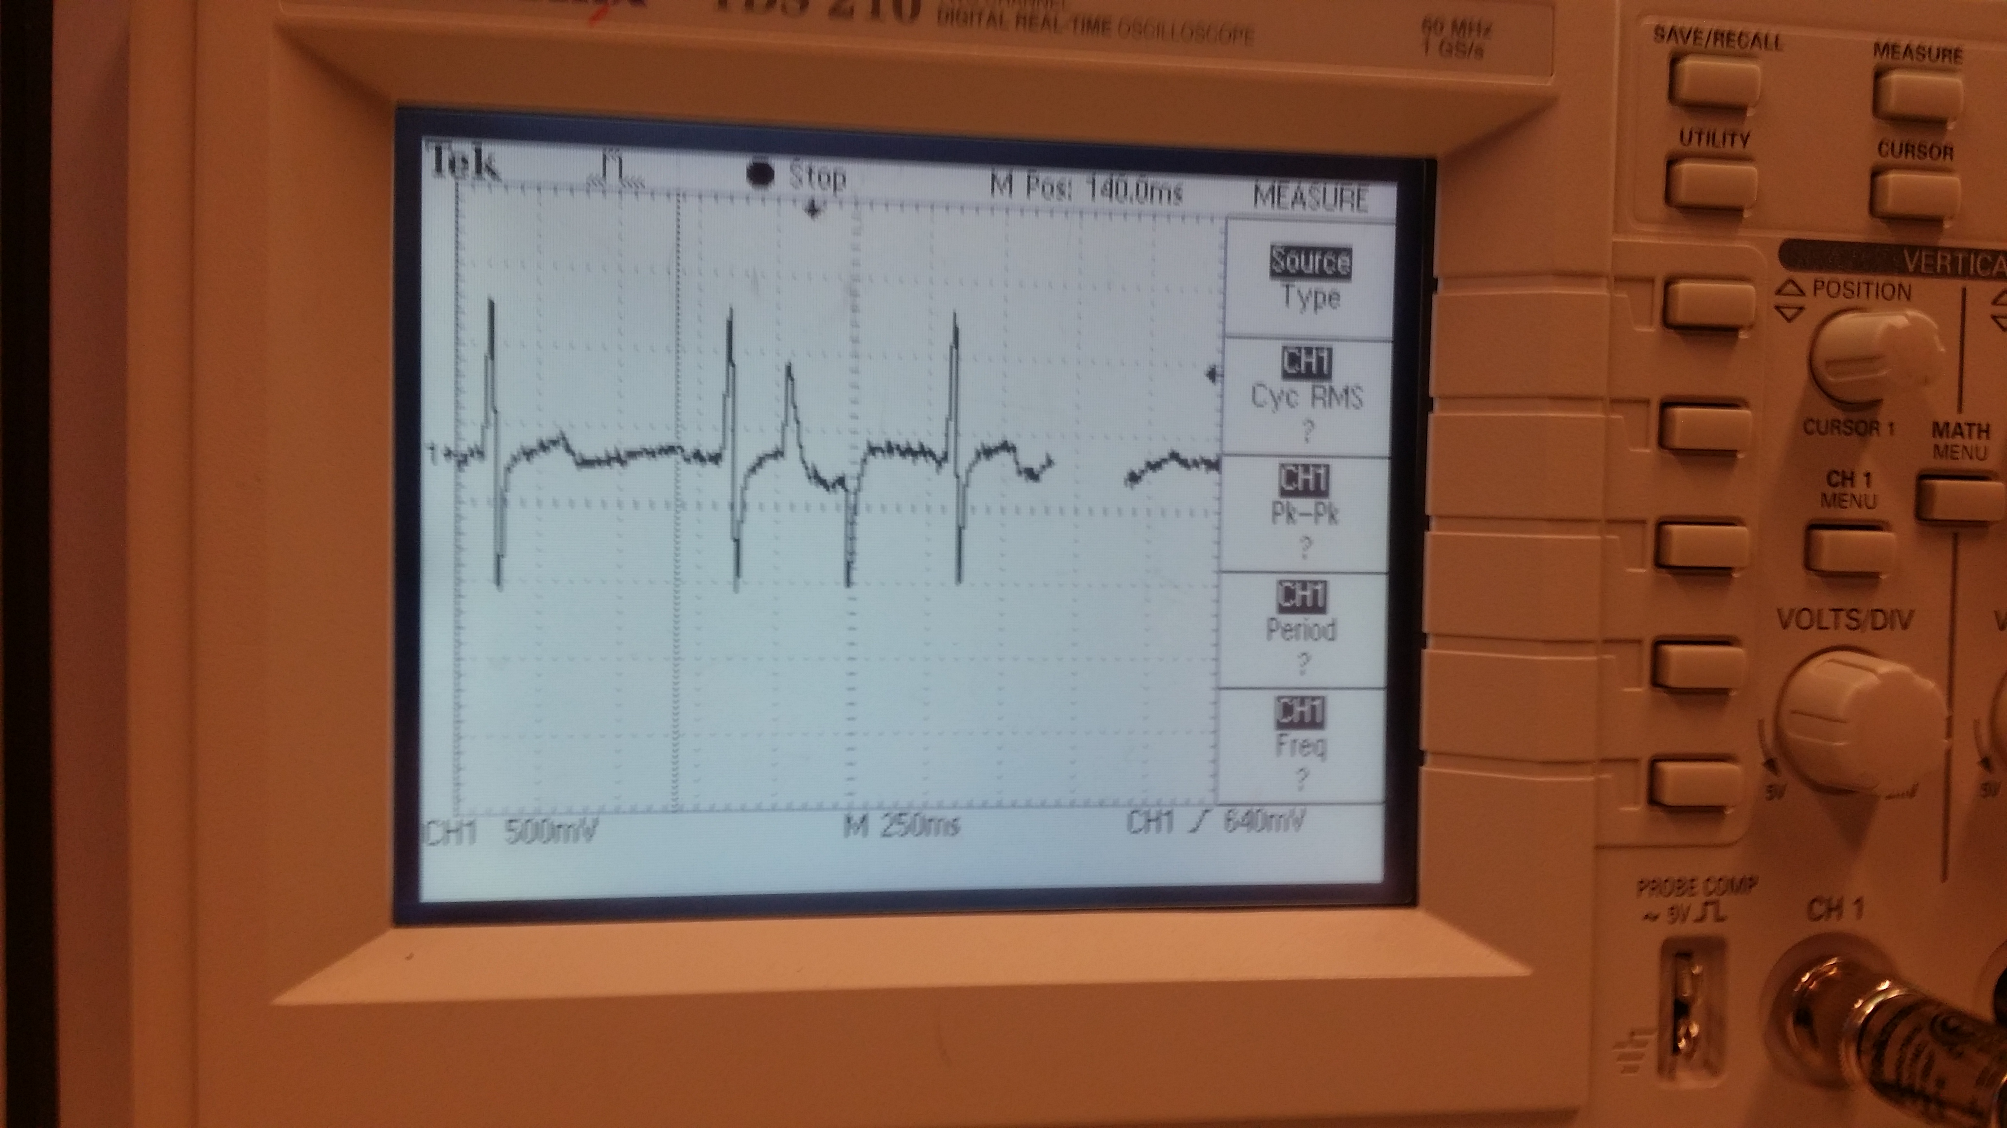

Slide 21
Demonstration

